Slide 1
Modern Service Management with Consul and Vault
Amit Khare | Steve Perkins

Slide 2
INTRO

Slide 3
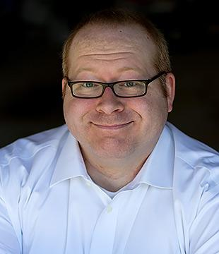

Intro
SPEAKERS
Steve Perkins - Software Architect
Amit Khare - Data Architect
SCOPE
Service discovery / load balancing / failover
Configuration management
Endpoint security and TLS
RESOURCES
https://github.com/steve-perkins/DevNexus-2017
Notes:
Steve, speaking from a developer’s perspective… Amit, speaking from an infrastructure perspective.
There’s a lot of sample code to cover, this GitHub repo catalogs it all. It will be shown again at the end of the presentation.

Slide 4
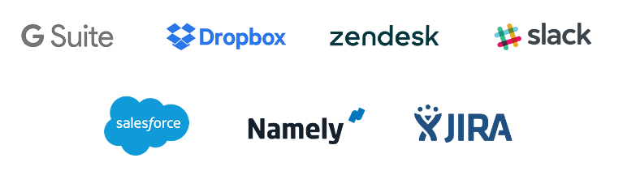
BetterCloud
MAGIC!
Notes:
BetterCloud is a SaaS company, providing automation and analytics for SaaS customers. We download customer data, do things that aren’t supported by the native API’s or tools, and then sync any changes.
The scale is very large, dealing with hundreds of terabytes of data.

Slide 5

Early Architecture
Google App Engine
Notes:
Originally, BetterCloud was focused exclusively on one SaaS provider (Google). So we used a more traditional monolithic architecture.

Slide 6
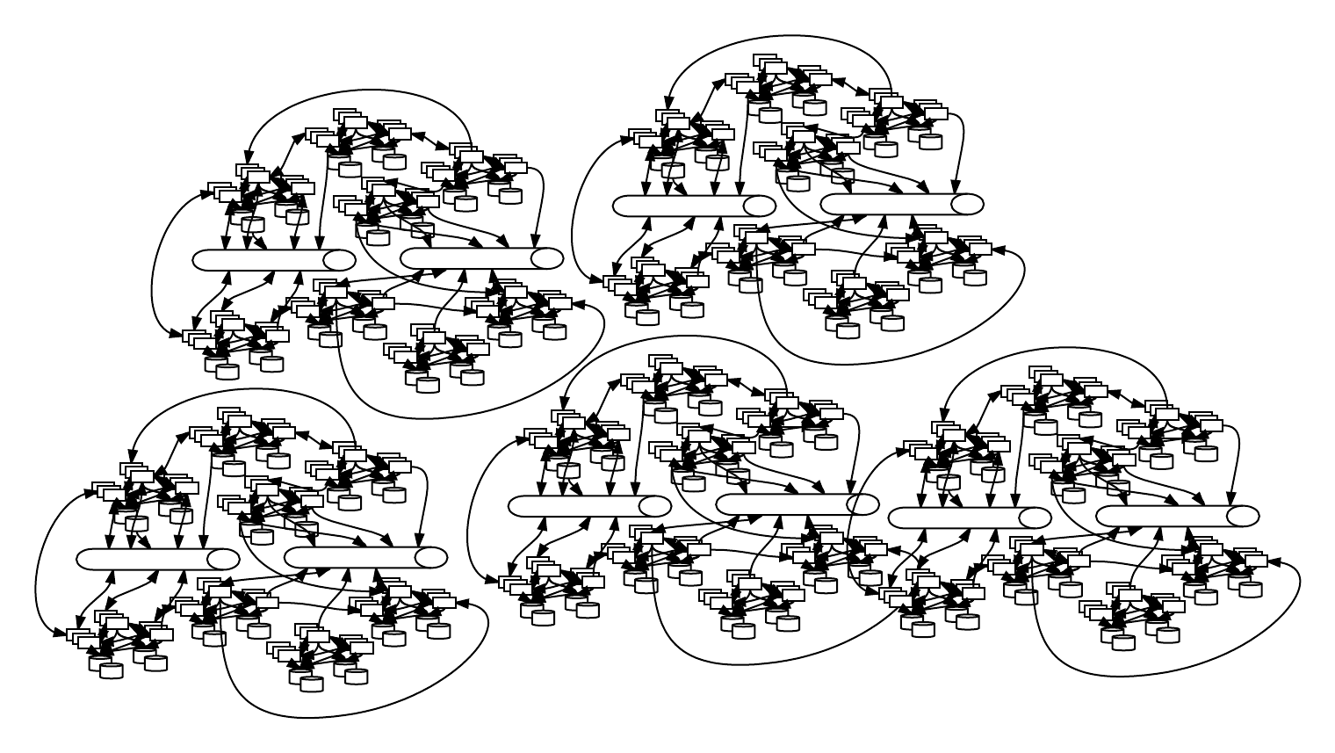



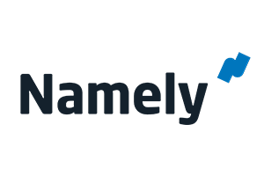



Current Architecture(*)
(*) not really
Notes:
We’ve expanded to connect with multiple SaaS providers, each with their own quirks. This drove us toward a more microservice-oriented architecture, with different areas of functionality having different scalability needs.

Slide 7


Slide 8
PROBLEM SPACE

Slide 9
Challenges Encountered
LOAD BALANCING / FAILOVER, AND SERVICE DISCOVERY
How to scale and un-scale linearly without having downtime and dynamically change load balancer based on scaling and removing services?
CONFIG MANAGEMENT
How to manage configuration, and dynamically change it across hundreds of services, without re-builds and re-deploys?
ENDPOINT SECURITY
How to ensure that REST and MQ endpoints are protected from external attackers, and also from the risk of services mistakenly talking to the wrong endpoint?
Notes:
In switching from a monolithic architecture to microservices, these are 3 of the problems that we had to come to grips with.

Slide 10
TECHNOLOGIES

Slide 11
Consul and Vault
CONSUL
Tool for Service Discovery and Configuration
Distributed, highly available and extremely scalable
Built-in health checks integrated with Service Discovery
Key/Value Storage
Datacenter Aware
VAULT
Highly Secure Secret storage
Dynamic Secrets
Data Encryption
Leasing and Renewal
Revocation
Notes:
TODO: Speaker notes

Slide 12
SERVICE DISCOVERY, ETC

Slide 13
Service Discovery
Problem
With Microservice Architecture, we want to scale our infrastructure real-time
Options
Use existing Nagios health checks and update LB configs with custom python scripts
Use Service Discovery integrated with Health Checks and update LB configs - Consul
Solution
Use Health Checks integrated with Consul Service Discovery
Use Consul-Template to update LB Configs based on changes on Service Discovery

Slide 14
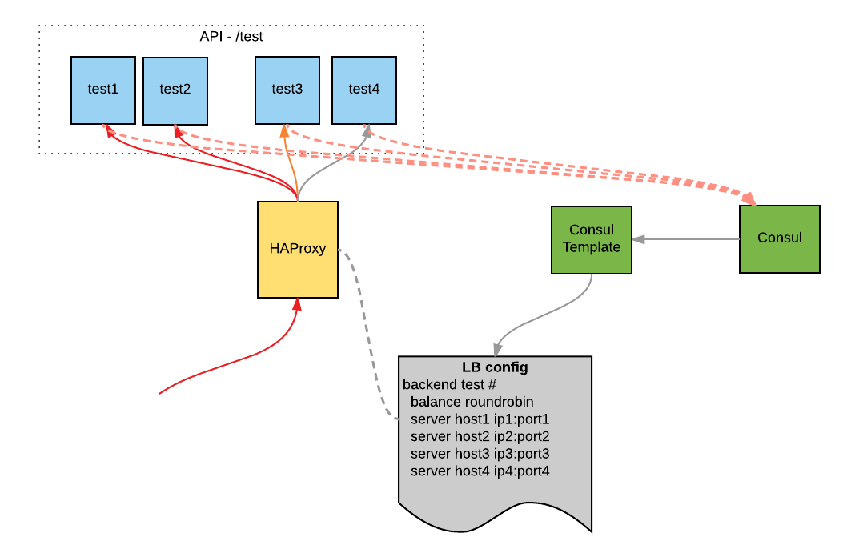

Slide 15
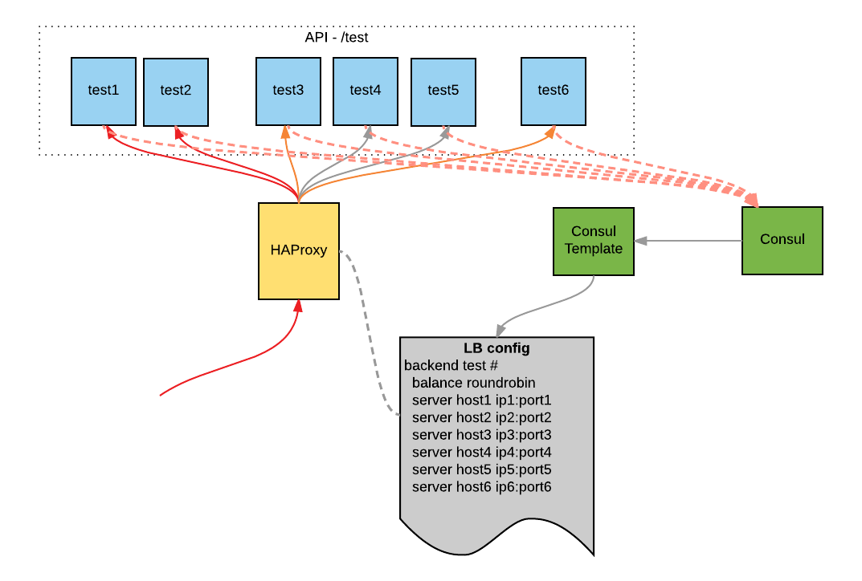

Slide 16
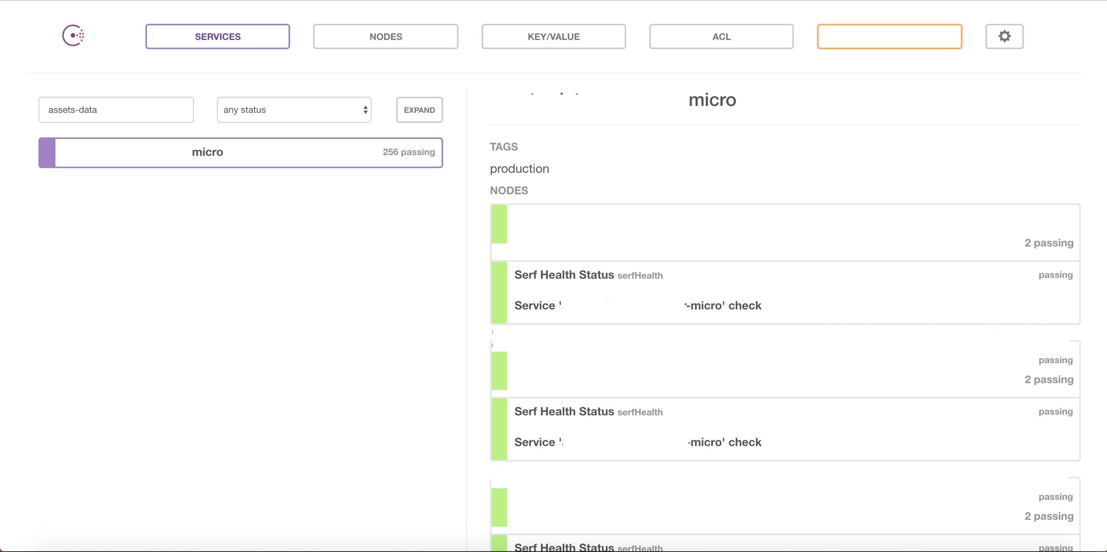
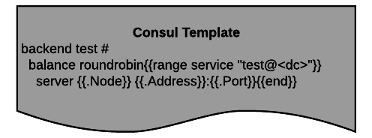

Slide 17
CONFIGURATION / PROPERTIES MANAGEMENT

Slide 18

Traditional Approaches
PROPERTIES FILES
Sometimes part of the build artifact, sometimes elsewhere on the filesystem
The former requires rebuilds and redeploys
The latter requires solutions for deployment and source control
Usually no perfect ownership model
If devs own it, then they can see things they shouldn’t
If ops/security, then it’s painful to manage changes
Can be cumbersome to manage differences across environments

Slide 19

Traditional Approaches
DATABASE TABLE
Lots of advantages
There’s usually an environment-specific DB anyway
Good for locking down access to “secret” values
Don’t need to rebuild or redeploy when properties changes
But still problems
Tracking change / source control
Facilitating change of “non-secret” values
Query DB every time, or only at startup?

Slide 20

Ideal Requirements
LARGE SCALE
Able to manage configuration across hundreds of apps, each in multiple environments
DYNAMIC
No need to rebuild or redeploy apps when their configuration changes
However, able to track (and revert) changes safely
SEPARATION OF RESPONSIBILITIES
Developers can maintain values where appropriate
Security / Ops can lock down values where appropriate

Slide 21
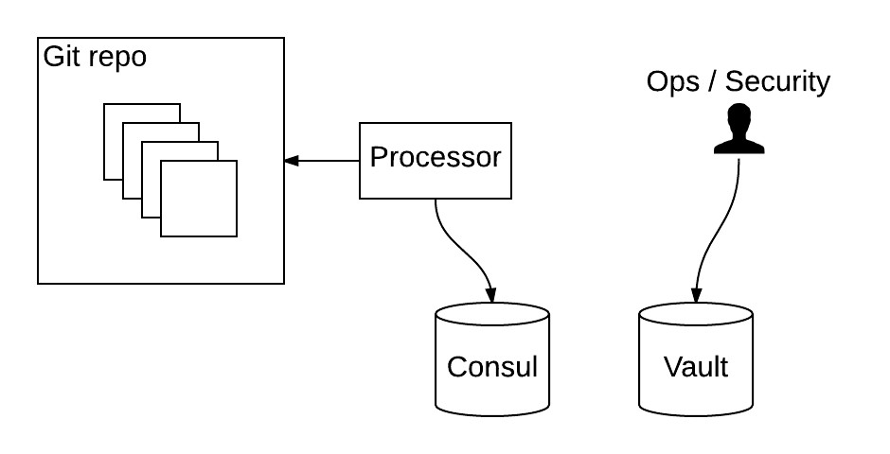
Example #1: Framework-agnostic

Slide 22
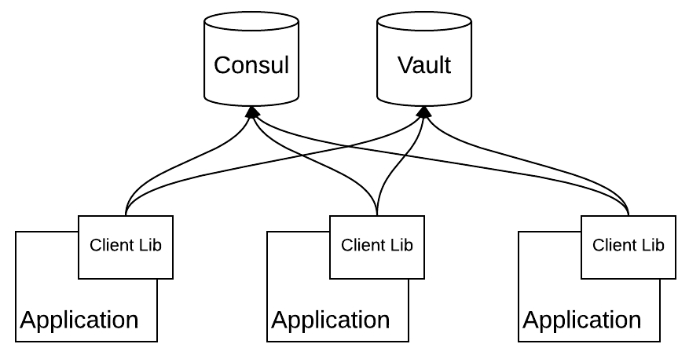
Example #1: Framework-agnostic

Slide 23
Example #1: Framework-agnostic
https://github.com/steve-perkins/config-properties - the properties files and Processor component
https://github.com/steve-perkins/config-client-lib - the shared library
https://github.com/steve-perkins/config-sample-app - a demo application under config managment

Slide 24
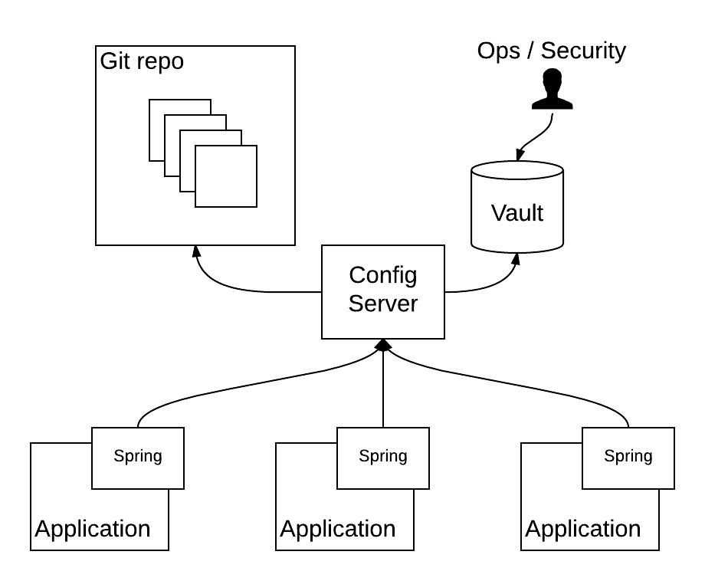
Example #2: Spring Cloud Config

Slide 25
Example #2: Spring Cloud Config
https://github.com/steve-perkins/spring-config-properties - the “non-secret” properties files
https://github.com/steve-perkins/spring-config-server - the Spring Cloud Config Server instance, configured for Vault/Git composite
https://github.com/steve-perkins/spring-config-sample-app - a demo application under config managment

Slide 26
SECURITY AND TLS

Slide 27
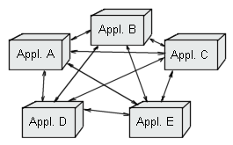
Microservices == More Internal Traffic
SEPARATING PROCESSES LEADS TO INCREASED IPC
HTTP
MQ
INCREASED IPC LEADS TO INCREASED RISK
External attackers
Internal negligence

Slide 28
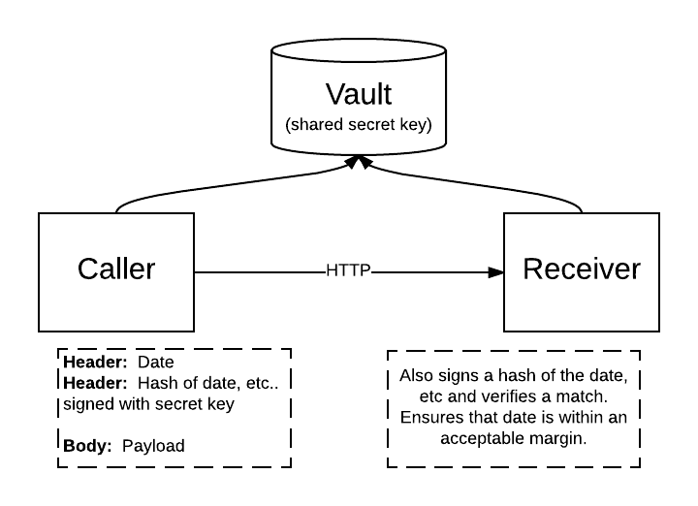
Secure HTTP Endpoints
HMAC
Uses a shared secret key (which could be stored in Vault)
Callers send a header, a hash of some values signed with the shared key
Receivers perform the same hash and verify a match
RESOURCES
https://en.wikipedia.org/wiki/Hash-based_message_authentication_code
Class javax.crypto.Mac in the JDK
Apache Commons Codec

Slide 29
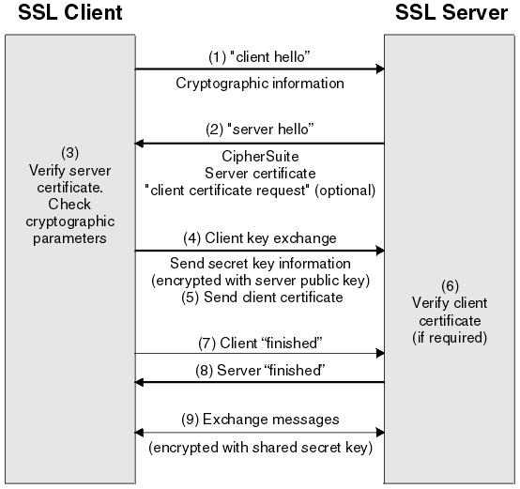
Secure MQ (and other infrastructure)
TRANSPORT-LAYER SECURITY (TLS)
Basic versus client authentication
VAULT AS A CERTIFICATE AUTHORITY
Vault can issue signed x509 certificates
Message brokers and other infrastructure components can be setup to recognize Vault-signed certs
RUNTIME ACCESS
Applications can request certs from Vault on the fly, and use them to connect to infrastructure components
Access controls can limit what a given cert is authorized to do

Slide 30
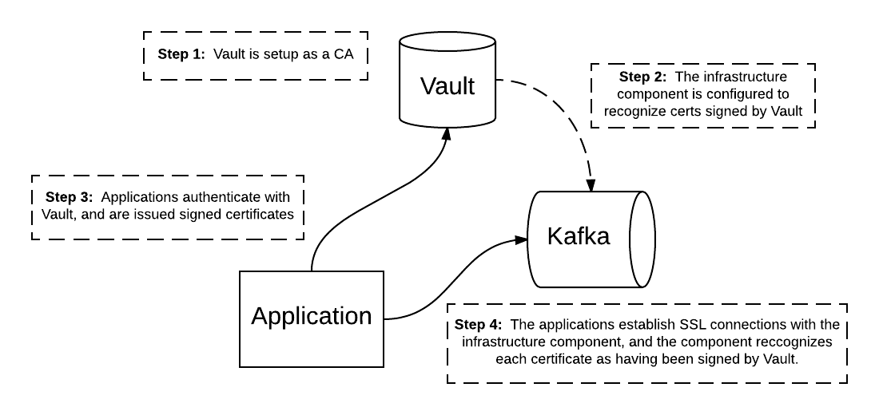
Example #3: TLS with Vault as a CA

Slide 31
Example #3: TLS with Vault as a CA
https://github.com/steve-perkins/kafka-tls-demo - Instructions for configuring Kafka with Vault, sample message producer and consumers.

Slide 32
Thanks!
https://github.com/steve-perkins/DevNexus-2017

